Slide 1
W8D2-Lecture
September 2020 LHL DS Bootcamp
Arunabh Singh

Slide 2
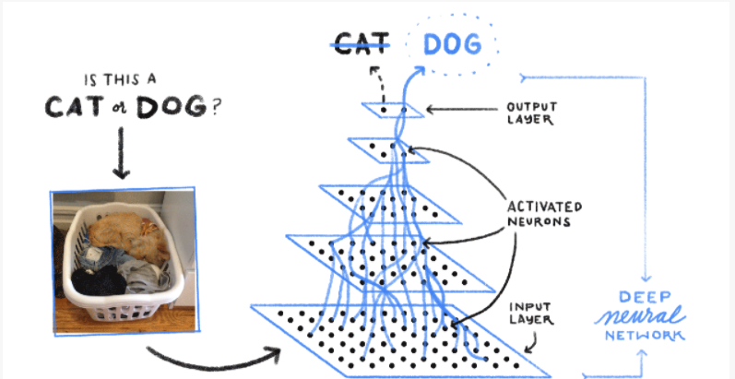
Why do we need other Neural Networks?
Can ordinary Neural Networks handle images?
Can it be done in a better way?
How will we handle connections between neurons for a very large image.
Why else are images different form regular data

Slide 3
Introducing CNN
Images have features. These features help determine what the image is about
To extract image features we need to pass filters over images
These filters capture intrinsic relation between different sections of the images
As these filters are passed through the image, features get detected like eyes, nose, mouth ears and other facial features or image features.
These layers form input to the other layers.
These layers capture relationship between these features.
Eventually as an image is passed via multiple convolutional and activation layers the prediction of image can happen.

Slide 4
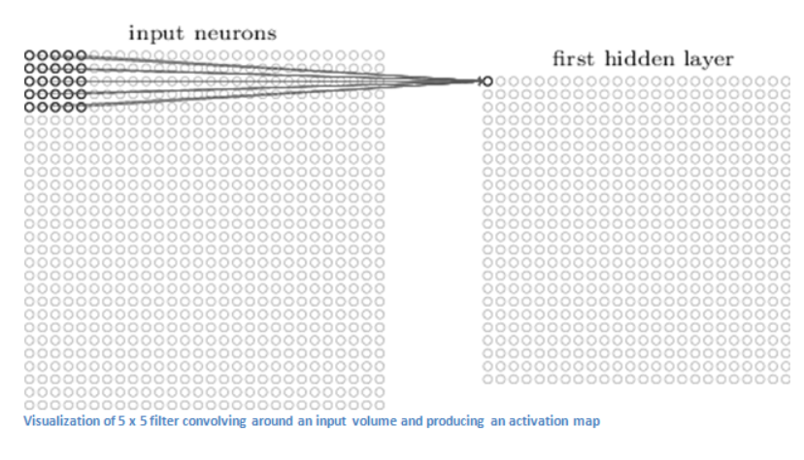
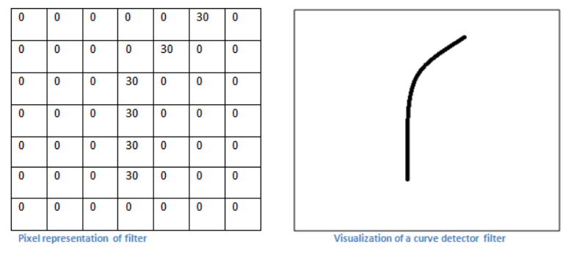
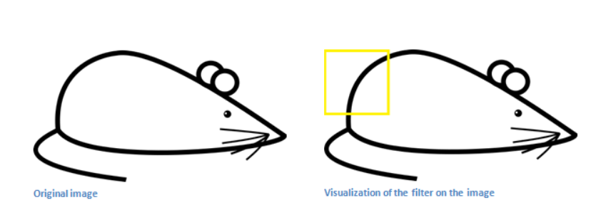
Convolution Layer
A filter is passed through an image like below to detect features like edge, colour and other curves in an image
A feature like image 2 will be used to detect a specific part of a mouse in image 3
Filters to detect various features are automatically decided by a CNN by adjusting its weights over time.
Image1
Image 2
Image 3

Slide 5
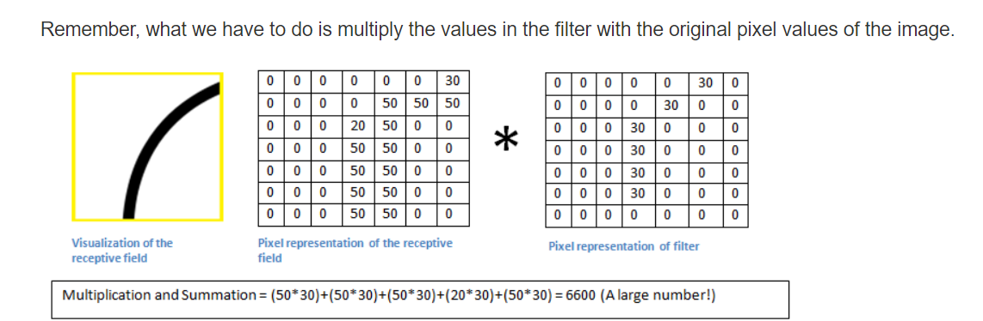
Edge Detection using dot product
When taking dot product of filter with image, if that specific feature exists, a large value is obtained.
When no detection happens value is low or 0.

Slide 6
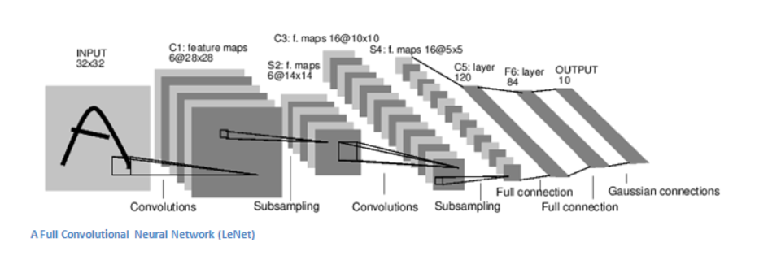
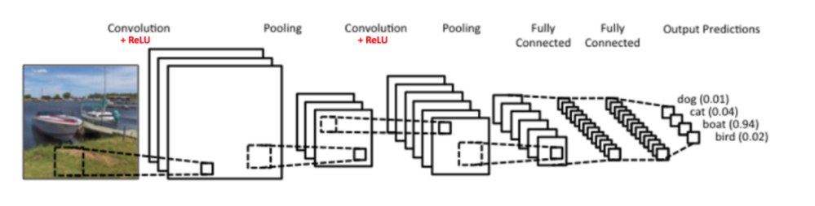
What does a CNN look like?
It consists of Conv Layers, pooling layers and fully connected Layers

Slide 7
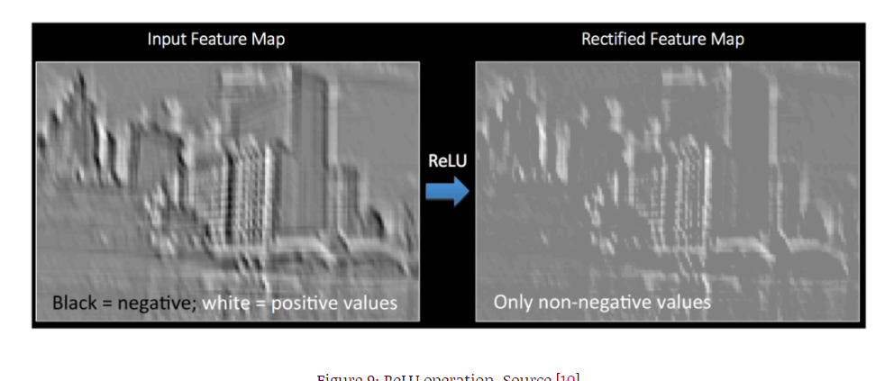
Why we need ReLU after convolving ?
ReLU removes negative values from a map/filter and only positive ones are retained.
It removes some unnecessary noise which is not useful in capturing features.
Below Image is an example of how it transforms the image.
Source: Deep Learning A-Z Kirill Eremenko-Udemy

Slide 8
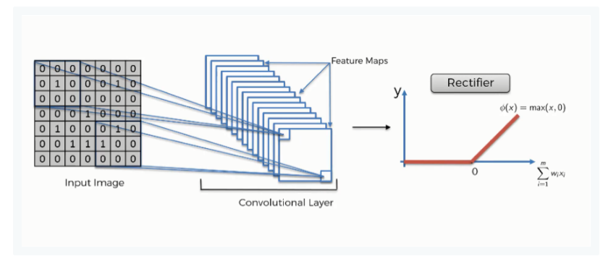
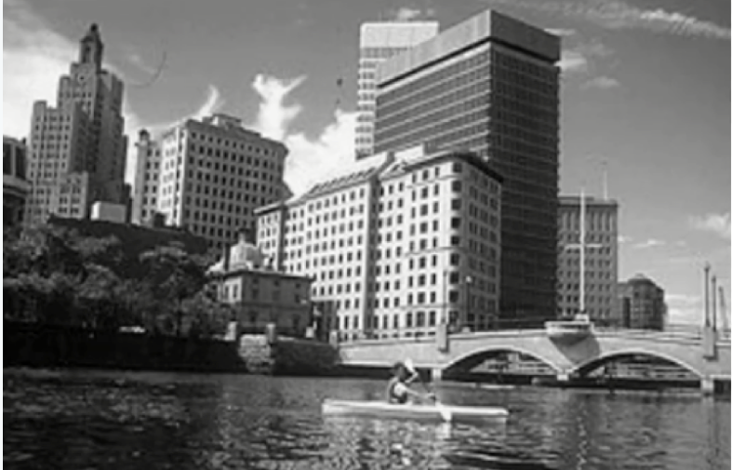
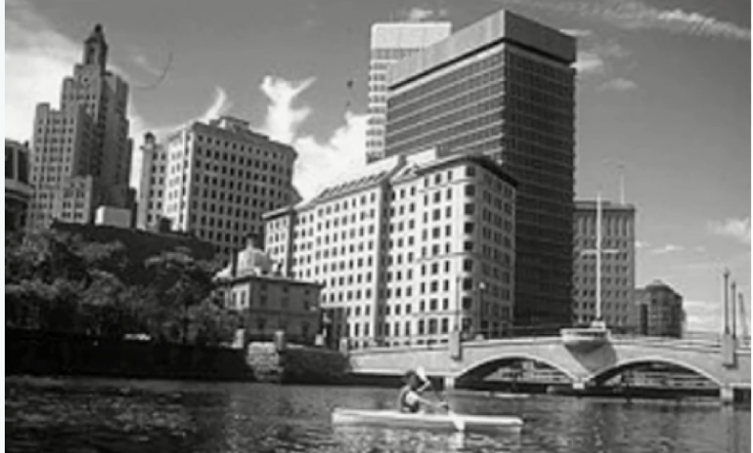
Convolution followed by ReLU
ReLU introduces non linearity in the image.
NN’s need non linearity to represent all kinds of relationships.
When you look at any image, you'll find it contains a lot of non-linear features (e.g. the transition between pixels, the borders, the colors, etc.).
Source: Deep Learning A-Z Kirill Eremenko-Udemy
Original image
Convoluted image followed by ReLU. Has a lot more in between grey scale values for pixels

Slide 9
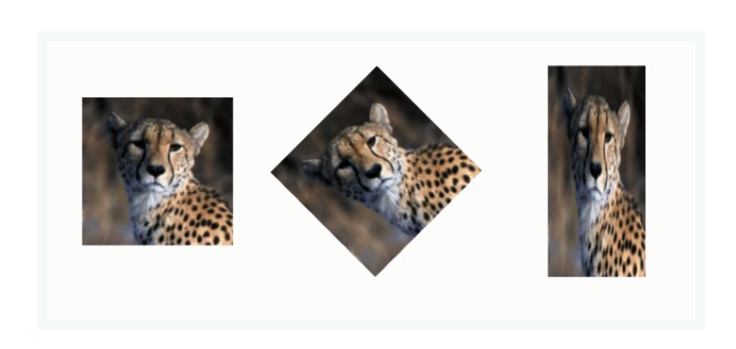
What is Max Pooling?
In the example, the same cheetah image is presented in different ways. It is normal in its first version, rotated in the second, and horizontally squashed in the third.
The purpose of max pooling is enabling the convolutional neural network to detect the cheetah when presented with the image in any manner.
Source: Deep Learning A-Z Kirill Eremenko-Udemy

Slide 10
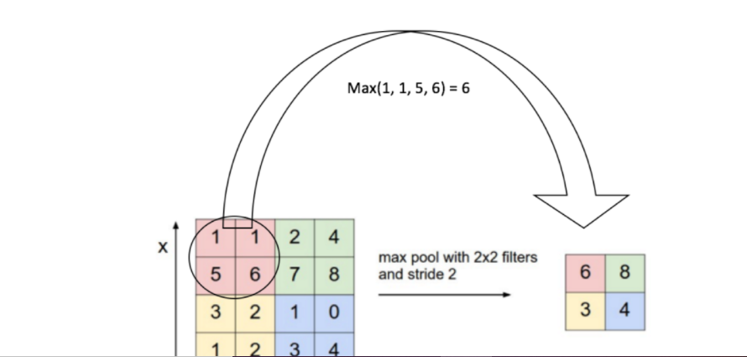
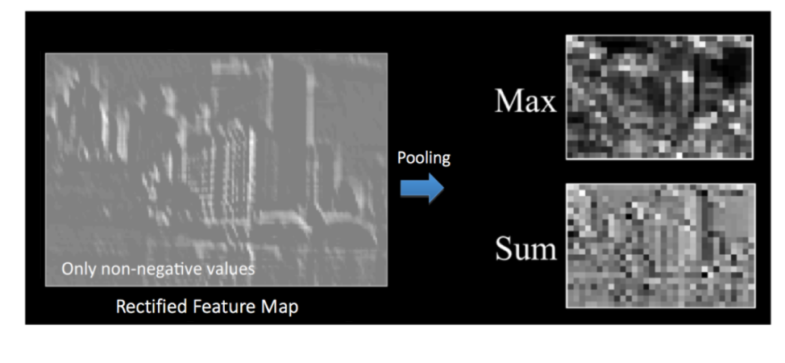
Why is pooling needed?
Pooling (also called subsampling or downsampling) reduces the dimensionality of each feature map but retains the most important information. Spatial Pooling can be of different types: Max, Average, Sum etc.
In case of Max Pooling, we define a spatial neighborhood (for example, a 2×2 window) and take the largest element from the rectified feature map within that window. Instead of taking the largest element we could also take the average (Average Pooling) or sum of all elements in that window. In practice, Max Pooling has been shown to work better.
Source: Deep Learning A-Z Kirill Eremenko-Udemy

Slide 11
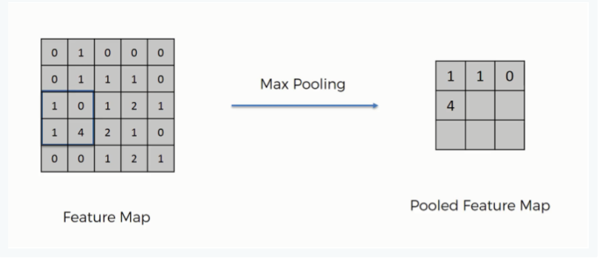
Types of Pooling
Before getting into the details, you should know that there are several types of pooling. These include among others the following:
Mean pooling
Max pooling
Sum pooling
Our main focus here will be max pooling.
Source: Deep Learning A-Z Kirill Eremenko-Udemy

Slide 12
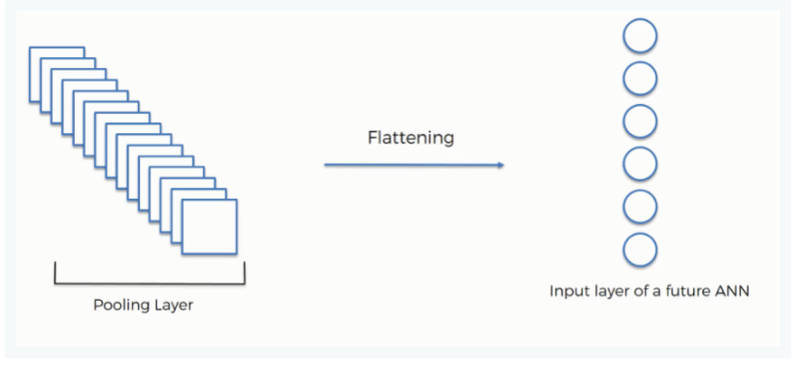
Flattening Layer of a CNN
After finishing the previous two steps, we're supposed to have a pooled feature map by now.
As the name of this step implies, we are literally going to flatten our pooled feature map into a column like in the image below.
The reason we do this is that we're going to need to insert this data into an artificial neural network later on.

Slide 13
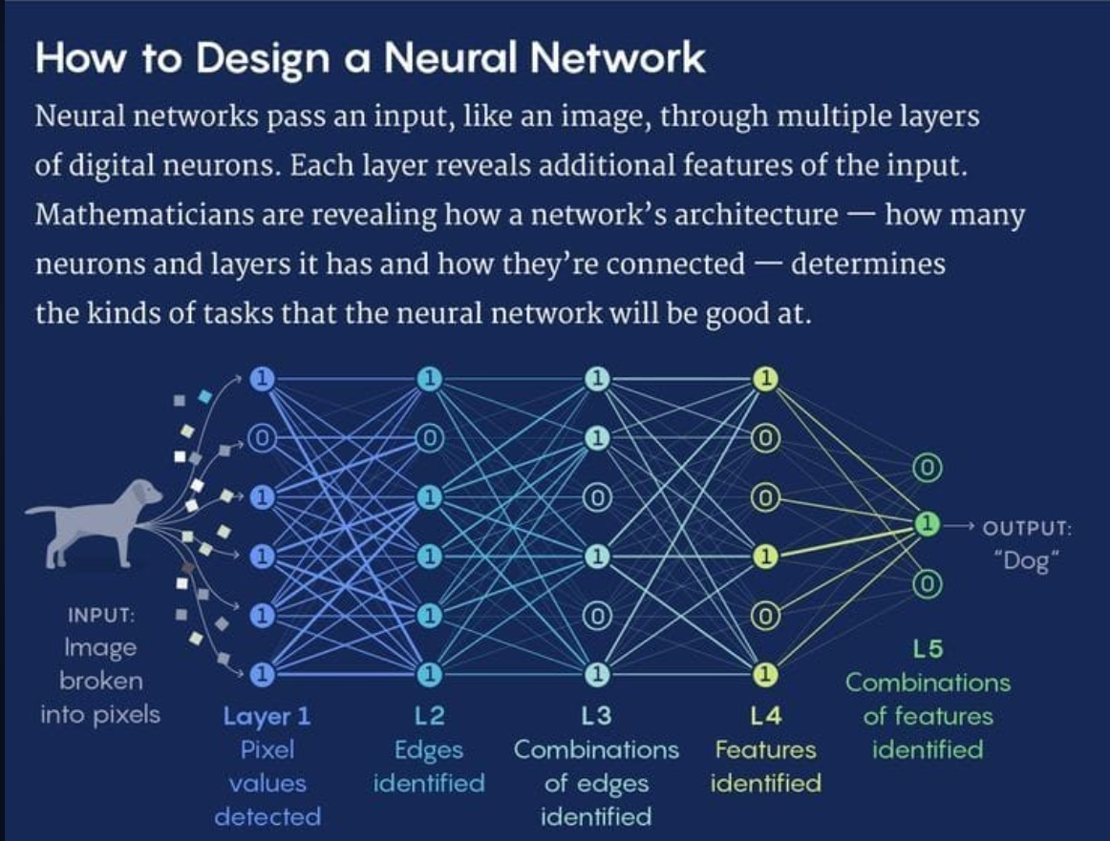
Source: Quanta Magazine

Slide 14
CNN Visualization layerwise
https://www.cs.ryerson.ca/~aharley/vis/conv/flat.html

Slide 15
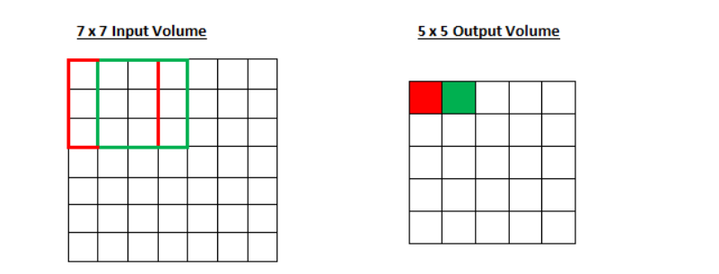
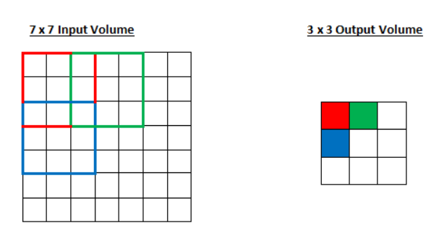
Filter sizes and Strides
Using a 3x3 filter on a 7x7 Input will result in a 5x5 output with stride 1
Using a 3x3 filter on a 7x7 Input will result in a 3x3 output with stride 2

Slide 16
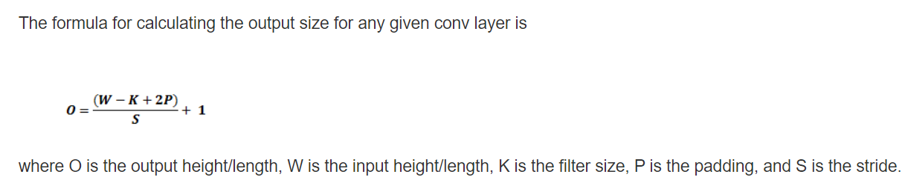
Calculating output from a Convolution Layer
Below is the formula
It also considers Padding which is bunch of 0s around a filter to detect edges of images which may otherwise be missed.

Slide 17
RNN

Slide 18
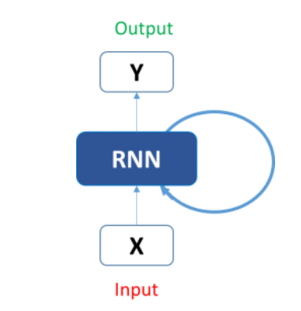
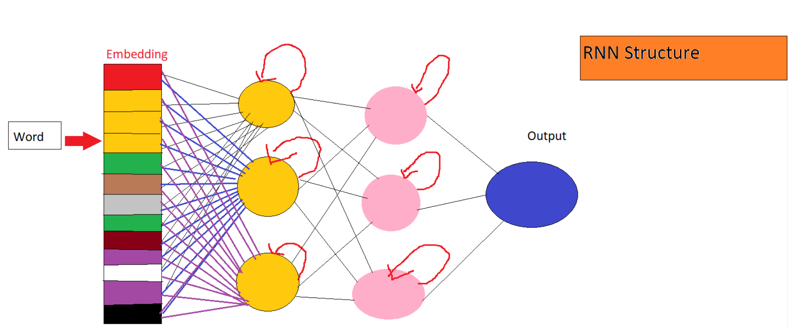
What is an RNN
RNN is a form of neural network that has recurrent cells.
An input to RNN consists of previous layer output as well as output from its CELL output from a previous time state at t-1.
So how do we take advantage of this ?

Slide 19
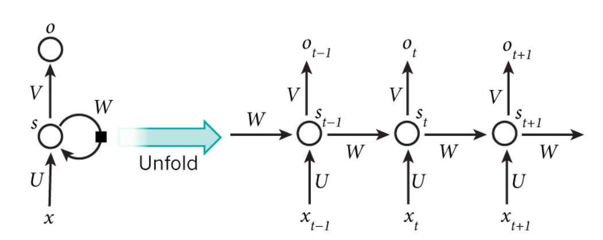
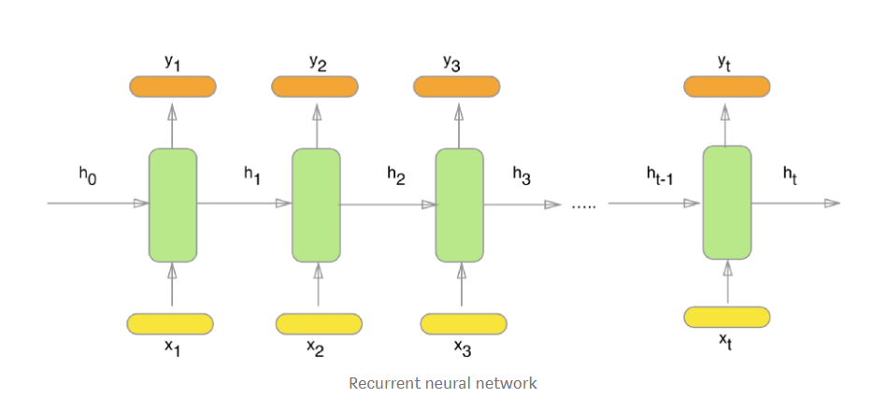
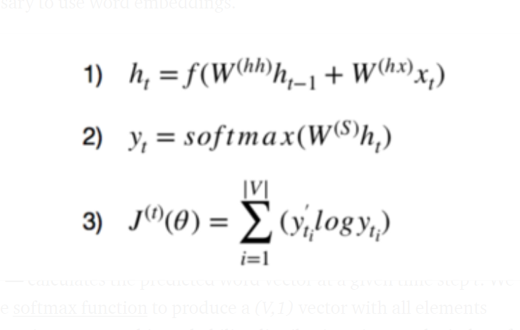
Unfolding an RNN
RNN node in a layer N will accept output from layer N-1 as input as well as input from its own cell generated at time t-1.
x_1, x_2, x_3, …, x_t represent the input words from the text, y_1, y_2, y_3, …, y_t represent the predicted next words and h_0, h_1, h_2, h_3, …, h_t hold the information for the previous input words

Slide 20
Sequential Models
RNN belongs to family of sequential models.
Sequential models have a property of using inputs from previous time state to predict current state.
Basically they rely on pas is predictor of the future. Which holds to true for sequential data.
Example of sequential data: stock price, text data etc.
For using text data in a machine learning format the text is split into words and each word is converted into a vector of numbers like [0.5,0.6,0.34,…..67] for a word like ‘trust’ and so on.
For the sequence ABCDEFGHIJKLMNOPQRSTUVWXYZ to know what comes after and this has to be learnt as sequence.
Similarly for the reverse sequence ZYXWVUTSRQPONMLKJIHGFEDCBA. That’s why it is hard to say it without thinking.
To predict j the model needs to know that its’ output was I previously and this input will go the model again and it will predict j.

Slide 21
WHY order matters ?
YOU may think why cant a regular neural network model what an RNN does and why do we need to learn a new architecture.
‘This movie is good. Is it not?’ -→[‘this’ , ‘movie’, ’is’, ’good’, ’NOT’]
‘This movie is NOT good’ -→[‘this’ , ‘movie’, ’is’, ‘NOT’,’ good’]
‘this is a very good movie’ -> [‘this’ ,’movie’,’good’,’very’]
It is important to know the sequence of words to predict correct sentiment or the next word in the sequence.
No information about sequence is captured above.
In other words it is underfitting or not fitting correctly to the data.

Slide 22
Types of RNN

Slide 23
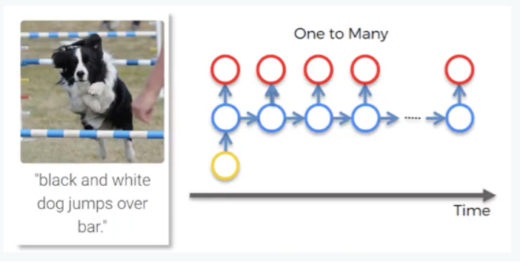
One to Many
This is a network with one input and multiple outputs.
For instance, it could be an image (input), which is described by a computer with words (outputs). You can see such example in the image below.
picture of the dog first went through CNN and then was fed into RNN. The network describes the given picture as “black and white dog jumps over bar”. This is pretty accurate, isn’t it?
While CNN is responsible here for image processing and feature recognition, our RNN allows the computer to make sense out of the sentence. As you can see, the sentence actually flows quite well.
Source: Deep Learning A-Z Kirill Eremenko-Udemy

Slide 24
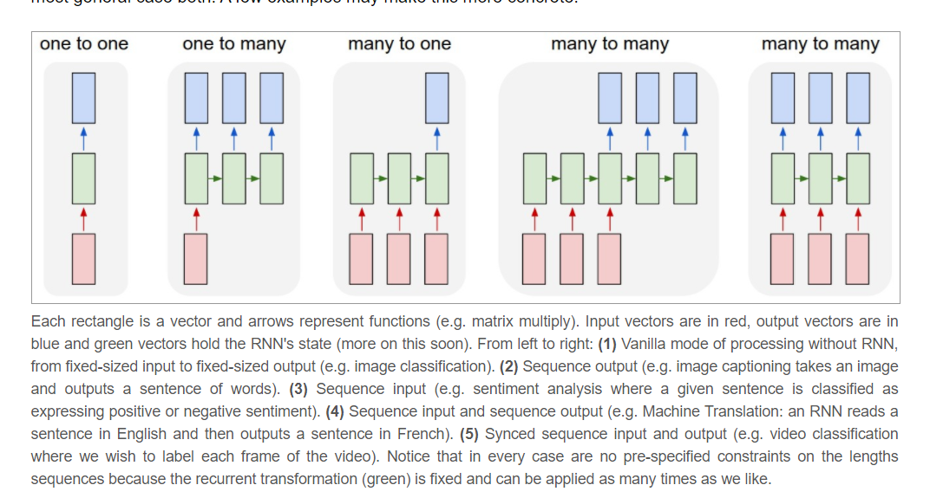
Other RNNs
Source: http://karpathy.github.io/2015/05/21/rnn-effectiveness/

Slide 25
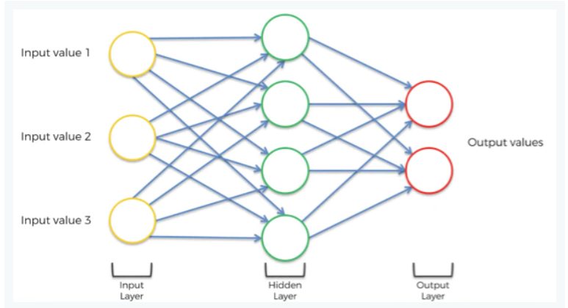
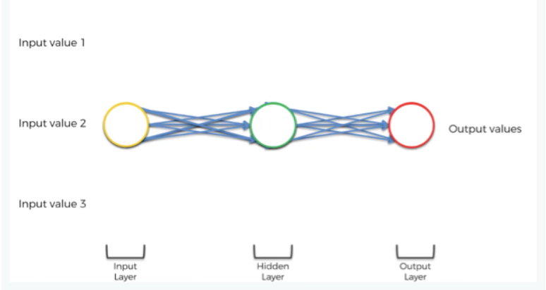
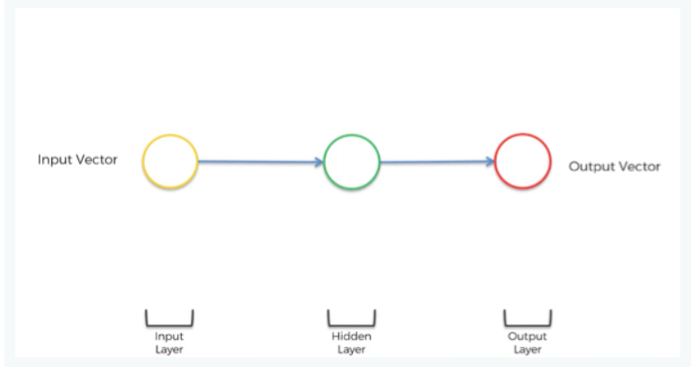
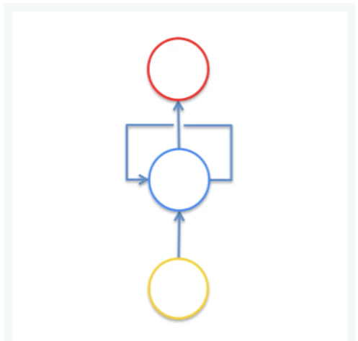
Understanding an RNN representation
Source: SuperDataScience.com / Deep Learning A-Z Kirill Eremenko-Udemy

Slide 26
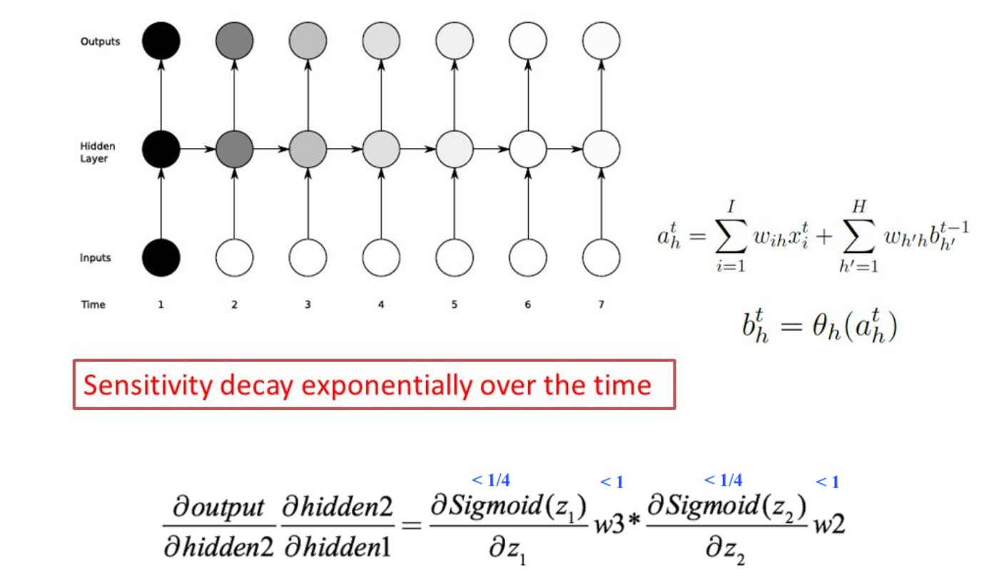
Vanishing and Exploding Gradient Problem
every single neuron that participated in the calculation of the output, should have its weight updated to minimize the error.
it’s not just the neurons directly below this output layer that contributed but all of the neurons far back in time
This causes an effect of gradients quickly turning to zero.
A zero gradient at a neuron means the weight will not update anymore.
Thus the far off layers from the output will tend to not contribute to the output as their weights are not correctly updated.

Slide 27
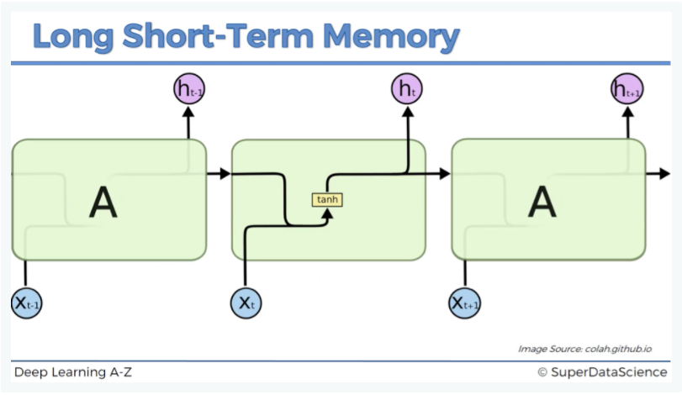
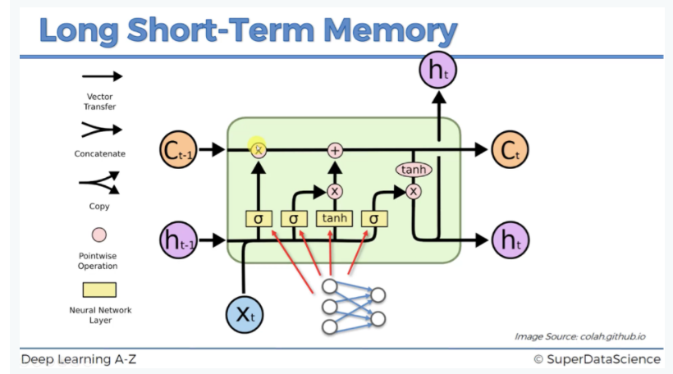
Enter LSTM
ct-1 stands for the input from a memory cell in time point t;
xt is an input in time point t;
ht is an output in time point t that goes to both the output layer and the hidden layer in the next time point.
Based on the values passed to tanh, sigmoid and other operations in a cell, an LSTM cell decides if a memory will be propagated to next cell or not and if the previous states will contribute to the current state.
Source: SuperDataScience.com / Deep Learning A-Z Kirill Eremenko-Udemy

Slide 28
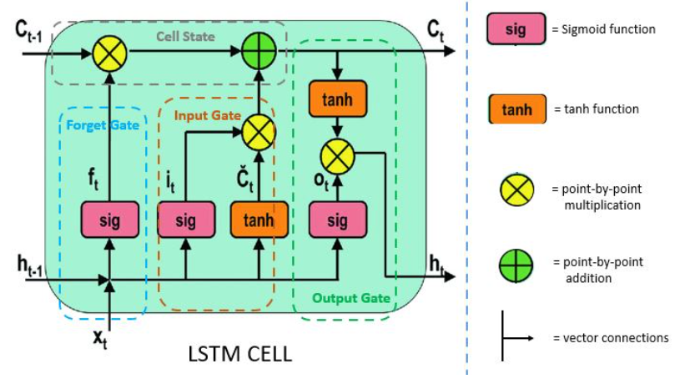
LSTM gates
Input Gate: Decides whether an input will be considered for calculation of an output or not,
Forget Gate: Whether previous learned concepts will be forgotten.
Output Gate: The output gate determines the value of the next hidden state. This state contains information on previous inputs.
Source:https://www.pluralsight.com/guides/introduction-to-lstm-units-in-rnn

Slide 29
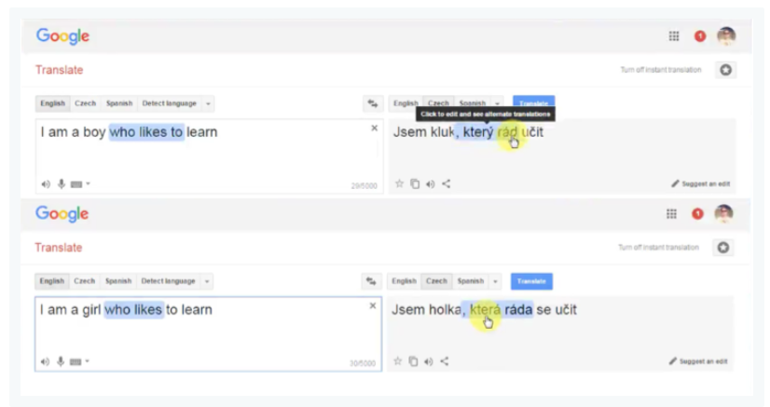
Example – language translation
when we change the word “boy” to “girl” in the English sentence
the Czech translation has two additional words changed because in Czech the verb form depends on the subject’s gender
The forget gate makes sure it forgets the boy part.
Input gate takes in girl as a word to calculate translation.
And thus the gates have effectively forgotten and remembered the appropriate parts of the sentence based on the changes in input.
Source: SuperDataScience.com / Deep Learning A-Z Kirill Eremenko-Udemy

